Slide 1
Recolorization of digital images
Using Computer Vision
Mihir Gupte - 19BCE1149
Subhomoy Banerjee - 19BCE1300
Siddharth Mehta- 19BCE1485

Slide 2
Introduction
Colorization of an image is very important as it gives a natural feeling to the pixels on the screen Grey scale images have been in existence since 1826. Images are nothing but matrix and using the right tools and Machine Learning Models, greyscale images can be easily colorized.

Slide 3
Problem Statement
Given a grayscale image, our task is to convert it into a RGB colour channel image with the help of a trained CNN. With this implementation we will be able to recolorise the old vintage photos from the older generations and bring life to them with the aid of a webapp in addition to this

Slide 4
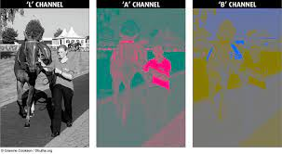
LAB color channel
Lab Color is a more accurate color space. It uses three values (L, a, and b) to specify colors. RGB and CMYK color spaces specify a color by telling a device how much of each color is needed. Lab Color works more like the human eye.

Slide 5
Methodology
Given the lightness channel L, our system predicts the corresponding a and b color channels of the image in the CIE Lab colorspace
Predicting color has the nice property that training data is practically free: any color photo can be used as a training example, simply by taking the image’s L channel as input and its ab channels as the supervisory signal.

Slide 6
Methodology
Color prediction is inherently multimodal – many objects can take on several plausible colorizations. For example, an apple is typically red, green, or yellow, but unlikely to be blue or orange. To appropriately model the multimodal nature of the problem, we predict a distribution of possible colors for each pixel.
We refer to a paper by Richard Zhang and implement their proposed approach in order to build this neural network.

Slide 7
Modules
The project is divided mainly into 3 modules -
Building a frontend website to get greyscale images
Training a CNN model to predict ab channel values
Building an API to integrate the model with the website

Slide 8
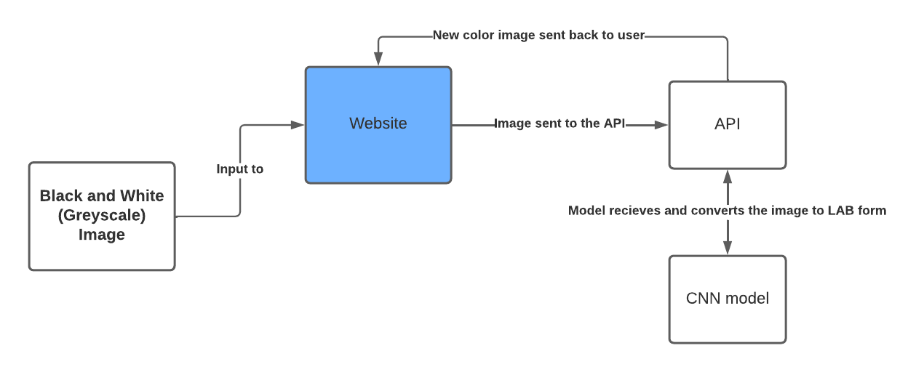
Architecture Diagram

Slide 9
Auto-Encoders
Auto-Encoders are an unsupervised learning technique in which we leverage neural networks for the task of representation learning. Specifically, we'll design a neural network architecture such that we impose a bottleneck in the network which forces a compressed knowledge representation of the original input

Slide 10
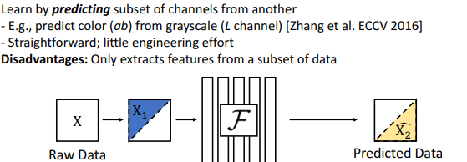
Cross Channel Encoding

Slide 11
Thank You!

